Slide 1

AUGUST 22-30, 2026
INSTITUTE OF GEOGRAPHY AND MILITARY HISTORY OF BRAZIL
ESTABLISHED ON NOVEMBER 7TH, 1936
AFFILIATED TO THE INTERNATIONAL COMMISSION OF MILITARY HISTORY (CIHM - ICMH)
The Home of Brazilian Military History

Slide 2
OBJECTIVES:
MAIN
STUDYING BORDER ISSUES... SHOWING IN PRACTICE A BORDER OF THREE COUNTRIES LIVING TOGETHER IN HARMONY... MORE THAN 80 NATIONALITIES LIVING TOGETHER IN A SINGLE CITY
ADDITIONAL
SHOW THE STRENGTH OF AGRIBUSINESS IN BRAZIL, THE SECOND LARGEST FOOD PRODUCER IN THE WORLD
IGHMB - CELEBRATING ITS 90TH ANNIVERSARY OF EXISTENCE

Slide 3

OUR LOGO
TWO STYLIZED HUMANS, IN GREEN AND RED COLORS (UNIVERSAL STANDARD FOR “GO” AND “STOP” TRAFFIC SIGNS), FRATERNIZING OVER A BANNER WITH THE WORD “BORDERS”.

Slide 4

Ighmb is the Brazilian commission of MILITARY HISTORY
SINCE 1936 RESEARCHING, HONORING AND DEFENDING BRAZIL
IGHMB, PHD (RHD) BRAZIL!

Slide 5


Slide 6

GENERAL GUIDELINES:
FOLLOW ICMH STANDARDS.
MAINTAIN USUAL COSTS (OR LESS).
DOCUMENTATION LANGUAGE - BILINGUAL (PORTUGUESE WITH ENGLISH TRANSLATION).
LANGUAGES OF ACADEMIC PRESENTATIONS (TEXTS AND LECTURES) - PORTUGUESE, ENGLISH AND SPANISH (WITH SIMULTANEOUS TRANSLATION SERVICES).
LANGUAGES OF SOCIAL OR TOURIST EVENTS - PORTUGUESE AND ENGLISH.
ACCOMMODATION AND ACADEMIC ACTIVITIES IN A SINGLE LOCATION (NO TRANSPORTATION NEEDED).

Slide 7
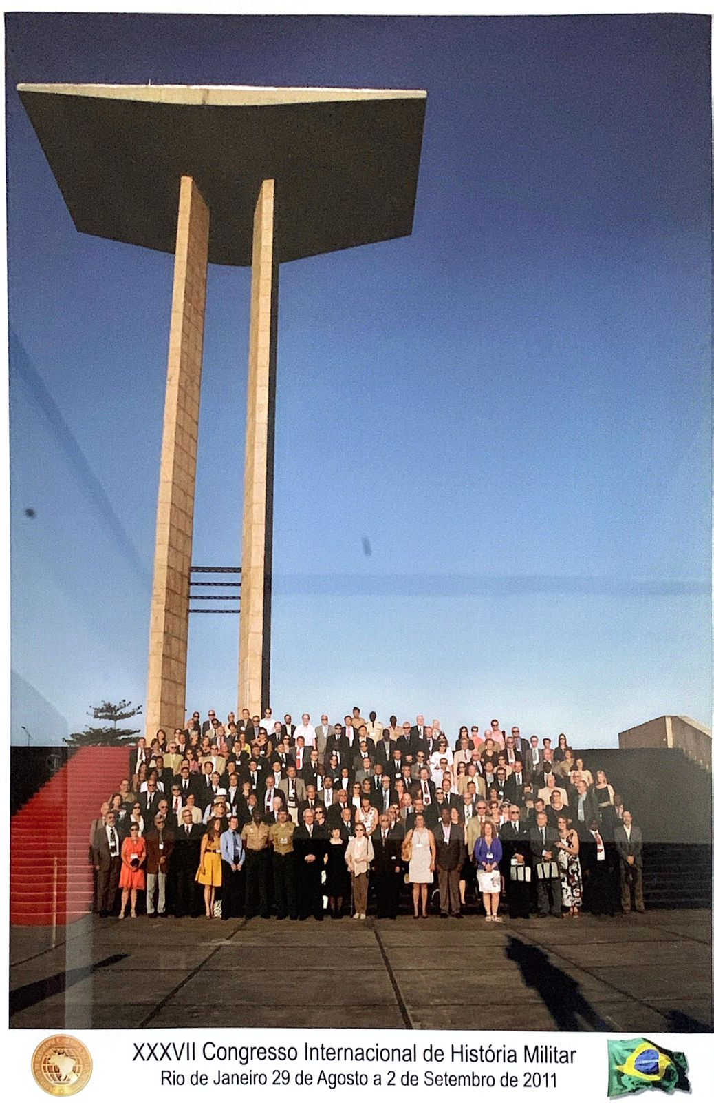
2011
XXXVII ICMH CONGRESS
RIO DE JANEIRO

Slide 8
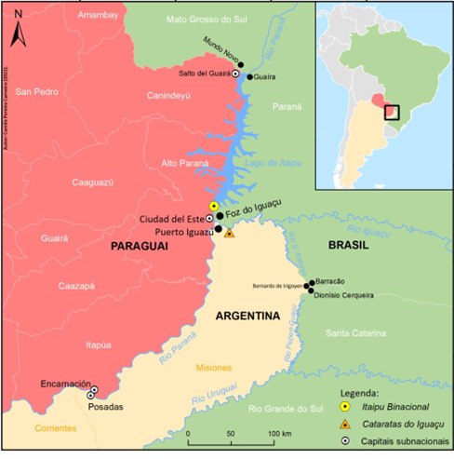
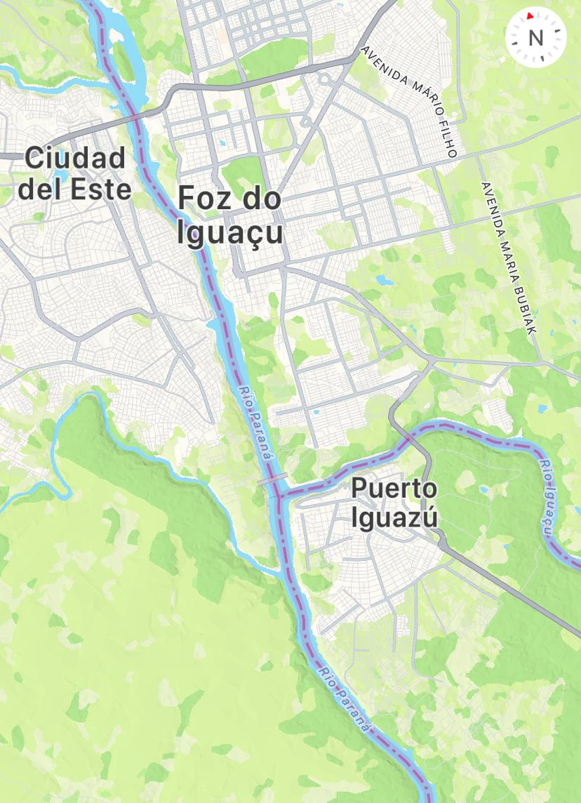
2026 - FOZ DO IGUAÇU = “THE MOUTH” OF IGUAÇU RIVER
THE SECOND MOST IMPORTANT TOURIST CENTER IN BRAZIL
BRASIL
PARAGUAY
ARGENTINA

Slide 9
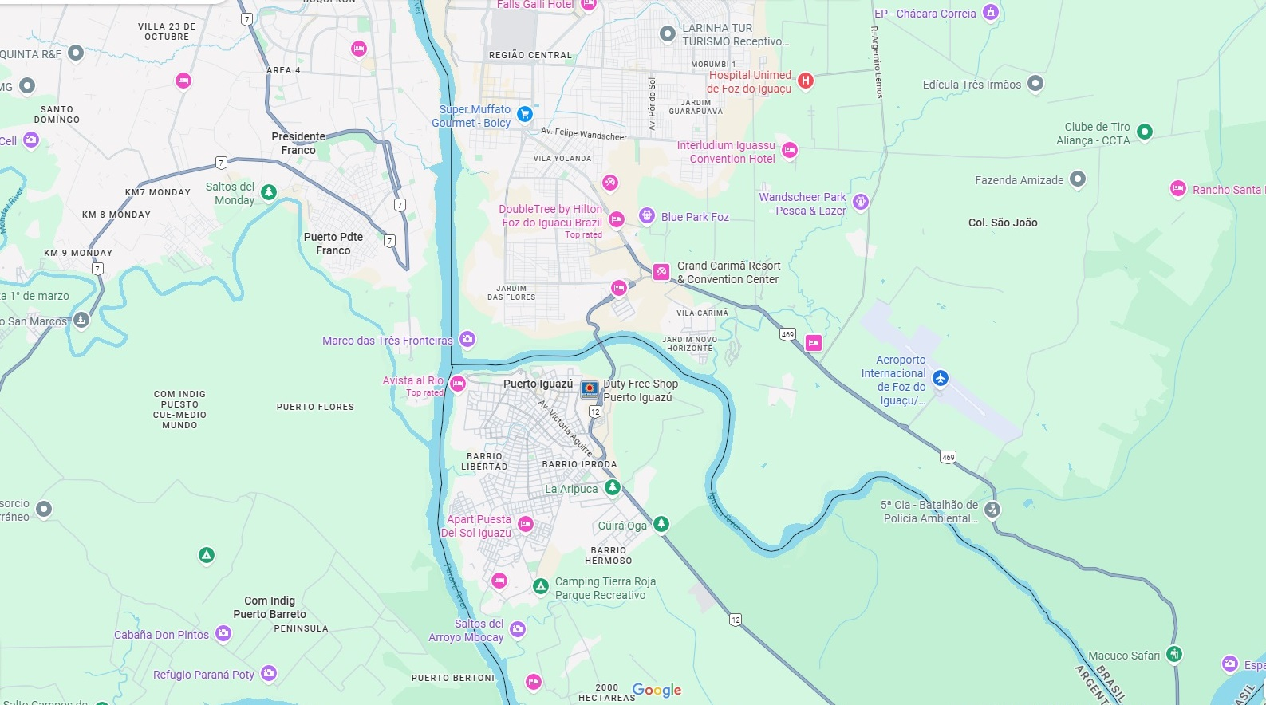
Mabu Thermas Grand Resort
Airport
BRASIL
Paraná river
PARAGUAY
ARGENTINA
Iguaçu river

Slide 10
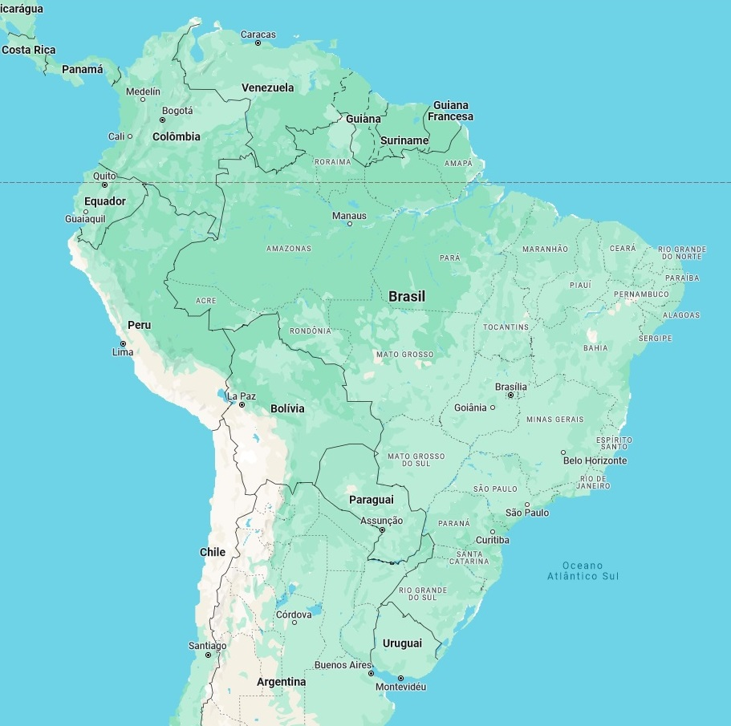
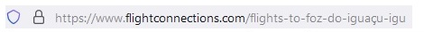
ARRIVING AT FOZ DO IGUAÇU
CURRENT (TODAY) FLIGHTS
PLANNED FLIGHTS
OPTION BUENOS AIRES/PUERTO IGUAZU
Foz do Iguaçu
SÃO PAULO, 3 airports:
Guarulhos (GRU)
Viracopos (VCP)
Congonhas (CGH)

Slide 11

GENERAL THEME AND SUBTHEMES
51st CONGRESS OF INTERNATIONAL COMMISSION OF MILITARY HISTORY
August 2026, Foz do Iguaçu, State of Paraná, Brazil.
CENTRAL THEME
“BORDERS: INTEGRATION AND HARMONY VERSUS SEPARATION AND CONFLICT”.
Sub Themes:
I) The advent of the Nation-States at the end of the 17th century and the territorial issues arising therefrom;
II) Borders as spaces between countries, regions or social groups, in order to understand physical, political, cultural, economic or symbolic limits;
III) Peace Missions in border conflicts;
IV) Geopolitical studies of borders;
V) Border wars; and
VI) Military-Tourist itineraries.
SEE ATTACHED DOCUMENT
ALTHOUGH THE THEME “BORDERS” IS HISTORICALLY AND INTIMATELY CONNECTED TO POLITICAL ACTIVITIES AND CONFLICTS, IT IS IMPORTANT TO EMPHASIZE THAT THE ACADEMIC WORKS TO BE PRESENTED MUST BE FREE FROM IDEOLOGICAL BIASES AND PARTICULARIZED PARTISAN POSITIONS.

Slide 12
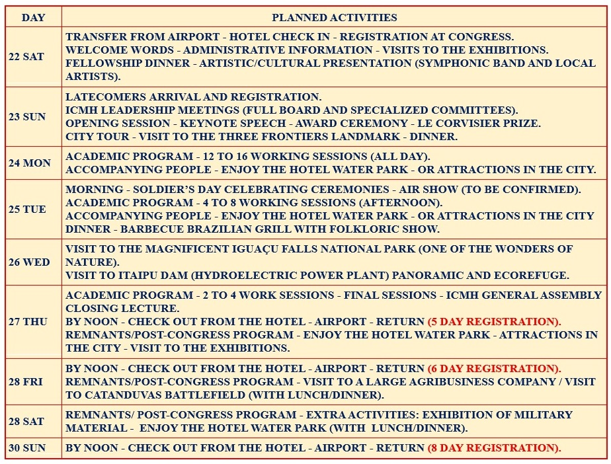
PROGRAM

Slide 13

COSTS AND PRICES
TO BE CHARGED 300 EUROS FROM EACH PARTICIPANT, AS USUAL.
PHD STUDENTS - REDUCED COSTS.
TO ATTRACT PARTICIPANTS FROM THE REGION, WE WILL RECEIVE POST GRADUATE AND GRADUATE STUDENTS FROM PARTNER UNIVERSITIES, AS WELL AS OTHER INTERESTED PARTIES, BOTH BRAZILIAN AND FROM NEIGHBORING CITIES (NEIDERING COUNTRIES). THESE PARTICIPANTS, AT REDUCED COST, WILL ONLY BE GRANTED ACCESS TO ACADEMIC ACTIVITIES (NOT SOCIAL AND TOURISM ACTIVITIES).
PAYMENTS CAN BE MADE IN ANY WAY: CASH, DEBIT OR CREDIT CARDS, BANK TRANSFER, PIX (BRAZILIAN SYSTEM, EQUIVALENT TO FASTER PAYMENTS IN UK AND FEDNOW, IN USA), EXCHANGE BROKERS.
WE HAVE REACHED AN AGREEMENT WITH THE HOTEL FOR SPECIAL, REDUCED PRICES FOR THE EVENT.

Slide 14
TYPES OF REGISTRATION
CO = MEMBERS OF THE ORGANIZING COMMITTEE
A = FULL CONGRESSPEOPLE, ALONE (ONE PERSON, IN A SINGLE ROOM);
B = FULL CONGRESSPEOPLE, WITH ONE COMPANION (TWO PEOPLE OCCUPYING THE SAME DOUBLE ROOM);
C = ENROLLED IN PHD PROGRAMS CONGRESSPEOPLE, AT A REDUCED RATE (ACCOMMODATED IN QUADRUPLE ROOMS, WITHOUT ACCESS TO THE THERMAL PARK).
E = EXTRA ATTENDEES/LISTENING PARTICIPANTS (INDIVIDUAL BASIS, NOT STAYING AT THE HOTEL - ACCESS ONLY TO THE ACADEMIC PRESENTATIONS, NOT TO THE PARK, TO SCHEDULED MEALS OR LOCAL TRANSPORTATION).
DAILY RATES BRL 1.090 (APPROXIMATELY 150 US DOLLARS) FOR SINGLE APARTMENT AND BRL 1.300 (APPROXIMATELY 180 DOLLARS) FOR DOUBLE APARTMENT. IMPORTANT TO NOTE - THESE VALUES CORRESPOND TO ACCOMMODATION AND FOOD
(THEY ARE NOT JUST "BED AND BREAKFAST").

Slide 15
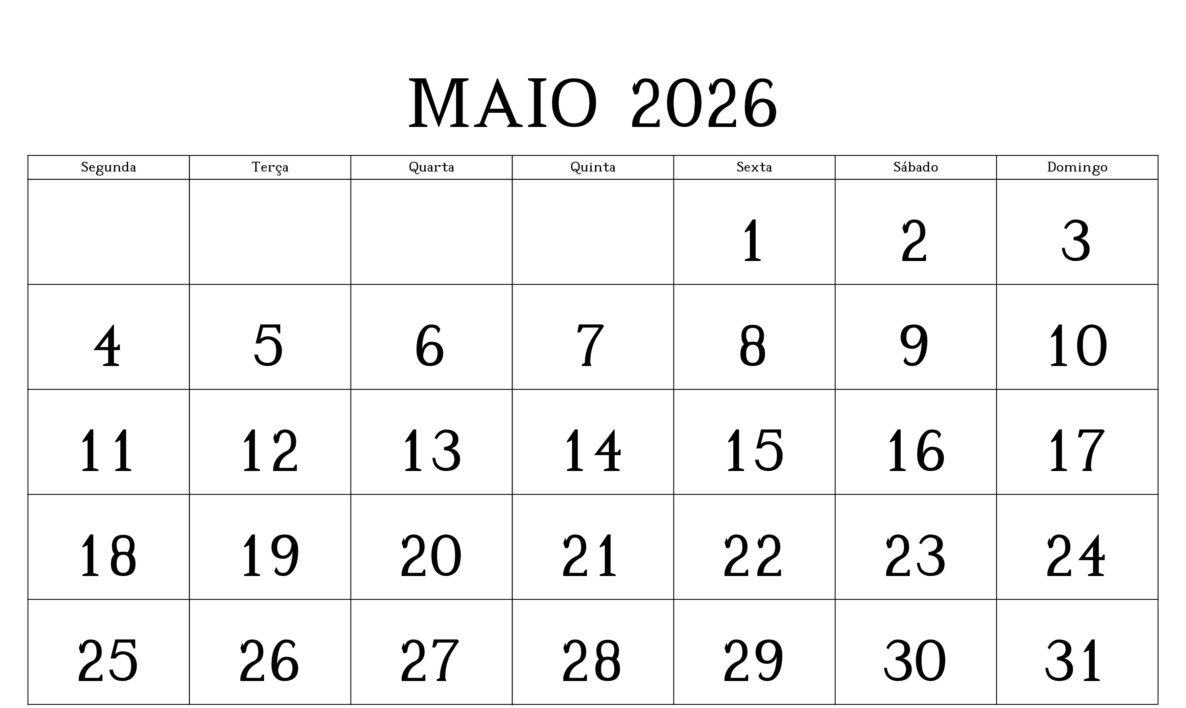
PARTICIPATION DAYS - REGISTRATION
5 DAY REGISTRATION = 5 HOTEL RATES - CHECK IN SAT 22 / CHECK OUT THU 27;
6 DAY REGISTRATION = 6 HOTEL RATES - CHECK IN SAT 22 / CHECK OUT FRI 28);
8 DAY REGISTRATION = CONGRESS PLUS POST-CONGRESS, 8 HOTEL RATES - CHECK IN SAT 22 / CHECK OUT SUN 30.
DEADLINE FOR REGISTRATION WITH NEGOTIATED (REDUCED) PRICES: MAY 29, 2026.
REGISTRATIONS MADE AFTER THIS DEADLINE WILL BE ANALYZED ON A CASE-BY-CASE BASIS, BUT WILL BE ACCEPTED, IF POSSIBLE, WITHOUT GUARANTEES OF PRICES OR HOTEL VACANCIES.

Slide 16
PHD PROGRAM
THE TRADITIONAL PHD PROGRAM OF THE INTERNATIONAL COMMISSION OF MILITARY HISTORY WILL HOLD ANOTHER OF ITS SESSIONS AT THE 51ST CONGRESS.
SPECIAL PARTICIPATION CONDITIONS WILL BE OFFERED THROUGH INCENTIVES, SUCH AS:
⇒ REGISTRATION FEE LESS OF €100;
⇒ ACCOMMODATION AT THE EVENT'S MAIN HOTEL, WITH A ROOM FOR 4 (FOUR) PARTICIPANTS COSTING ABOUT €60 PER PERSON PER NIGHT (ATTENTION = NO ACCESS TO THERMAL WATER PARK).
OPTIONAL = IT WILL BE EASILY POSSIBLE TO FIND ACCOMMODATION FOR ABOUT 250 EUROS PER WEEK (SEVEN DAYS), PER PERSON.
HOWEVER, TRANSPORT ARRANGEMENTS WILL DEPEND ON THE NUMBER OF REGISTRATIONS AND THE DIVERSITY OF HOTELS. WE WILL BE WORKING IN THE SEARCH OF THE MOST ECONOMIC ALTERNATIVES. TRAFFIC IN THE CITY IS NOT COMPLICATED AND TRAVEL TIMES WILL BE SHORT.
ESTABLISHED PROCEDURES REGARDING THE CORVISIER AWARD.
FINALLY, IT IS THE INTENTION TO ENCOURAGE STUDIES OF THE TOPICS, PROMOTING THE EVENT RIGHT NOW AND INVITING STUDENTS FROM UNILA (FEDERAL UNIVERSITY OF LATIN AMERICAN INTEGRATION) TO PARTICIPATE. THIS UNIVERSITY IS A BRAZILIAN PUBLIC HIGHER EDUCATION INSTITUTION BASED IN THE CITY OF FOZ DO IGUAÇU, GATHERING STUDENTS FROM DIFFERENT COUNTRIES. AIM AT ACADEMIC EXCHANGES AND SOLIDARY COOPERATION WITH MERCOSUR COUNTRIES AND OTHER COUNTRIES IN LATIN AMERICA.

Slide 17



MABU THERMAS GRAND RESORT
THE HOTEL ITSELF IS ALREADY A HUGE TOURIST ATTRACTION. IT IS A RESORT, WITH HOT WATER SPRINGS. A THERMAL PARK IS ATTACHED TO THE HOTEL
ALL IN ONE PLACE:
CONVENTION CENTER, ACCOMMODATION, FOOD AND LEISURE.
LESS THAN TEN MINUTES FROM THE AIRPORT;
IN FRONT OF A HUGE SHOPPING CENTER (JUST CROSS THE AVENUE).

Slide 18
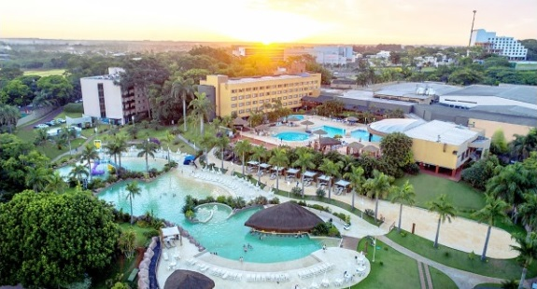
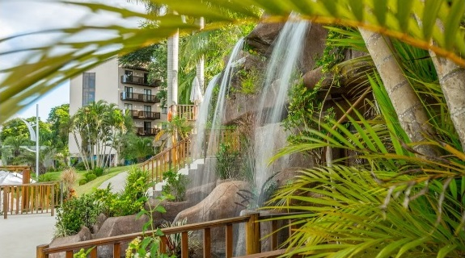
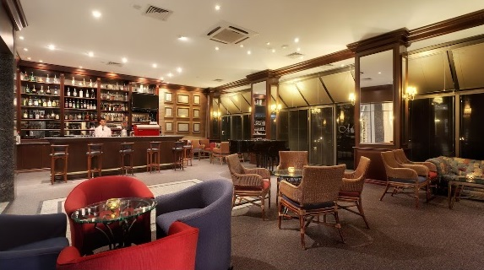
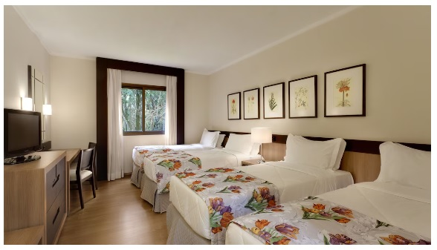
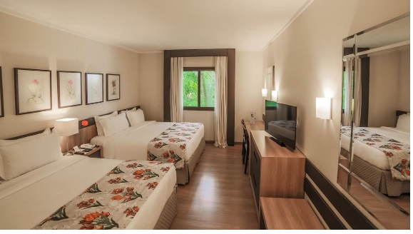
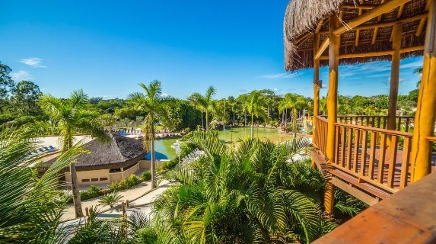
ACCOMMODATIONS AND FACILITIES

Slide 19
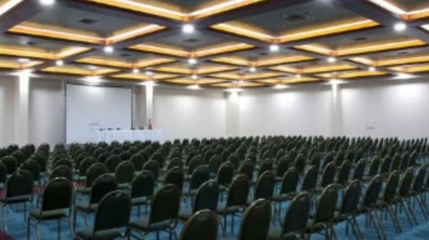
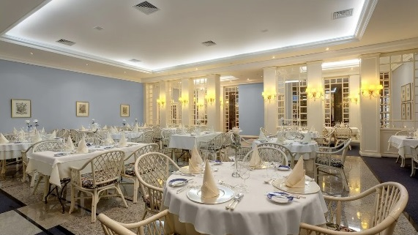
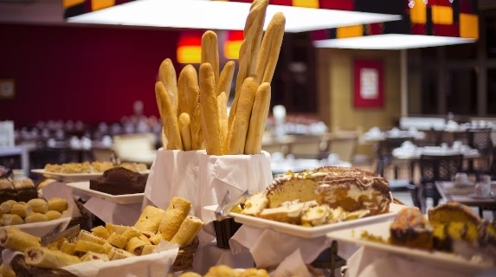
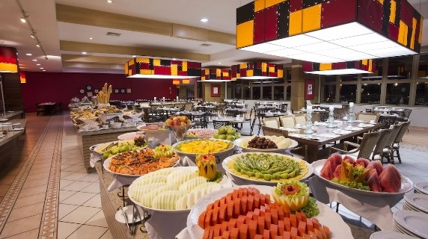
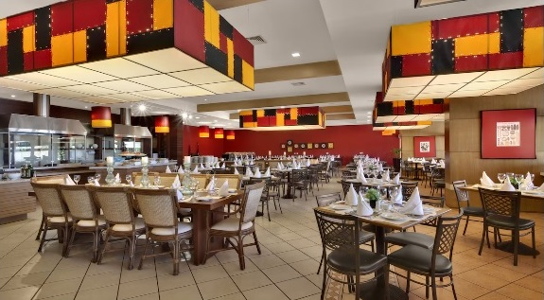

Slide 20
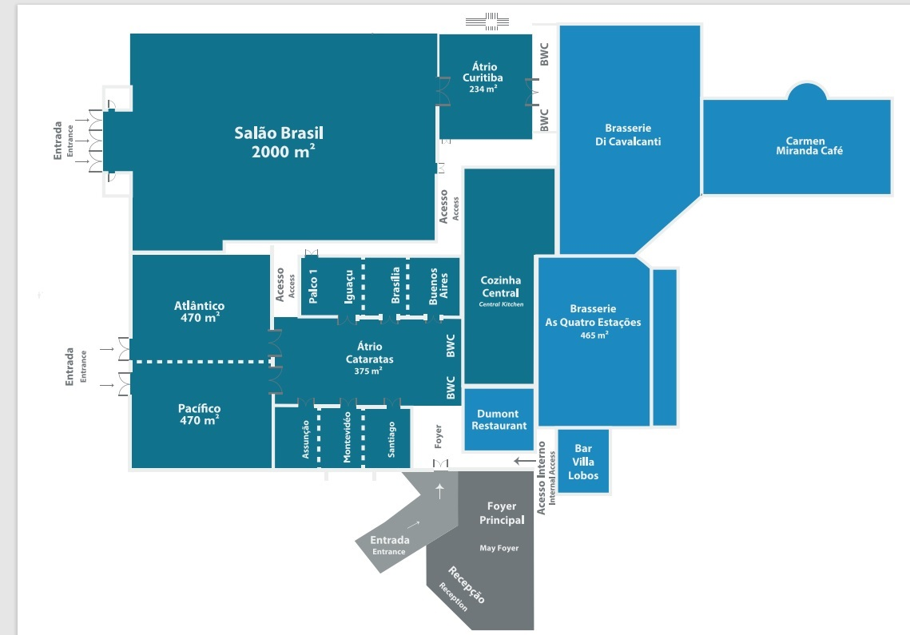
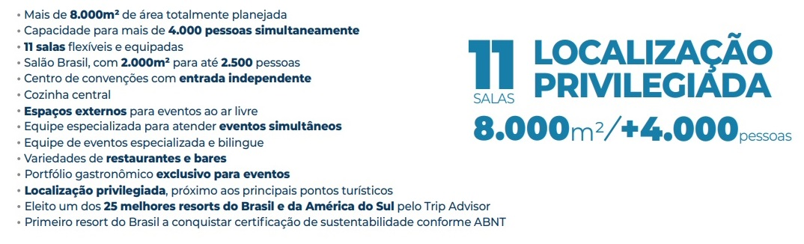
11 (ELEVEN) ROOMS AVAILABLE FOR SIMULTANEOUS WORK
MAIN AUDITORIUM - 2,000 M² - 2,500 PEOPLE
CONFERENCE ROOMS = MODULABLE
POSSIBLE ARRANGEMENTS - ROOMS 470 M²
2 X 700 PEOPLE OR 1 X 1,200
6 SMALLER ROOMS
6 x 90 PEOPLE OR 1 X 270 + 3 X 90
2 X 270 OR 2 x 180 + 2 X 90

Slide 21
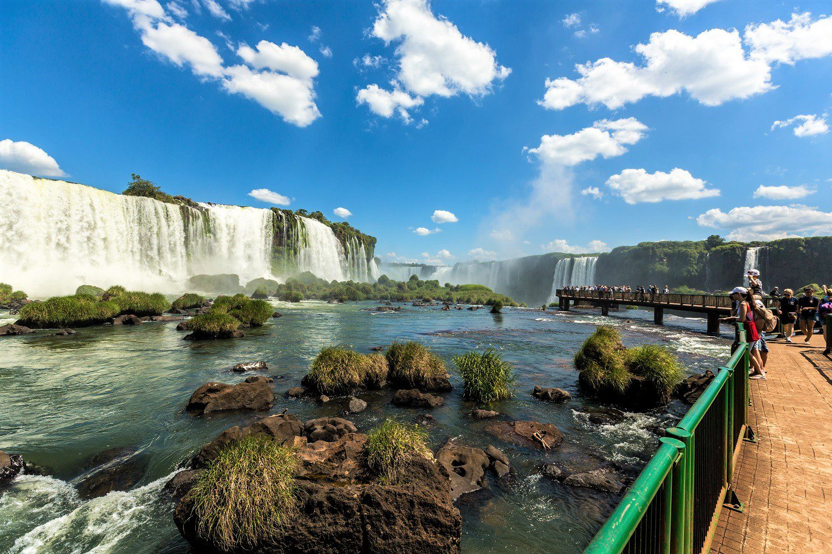
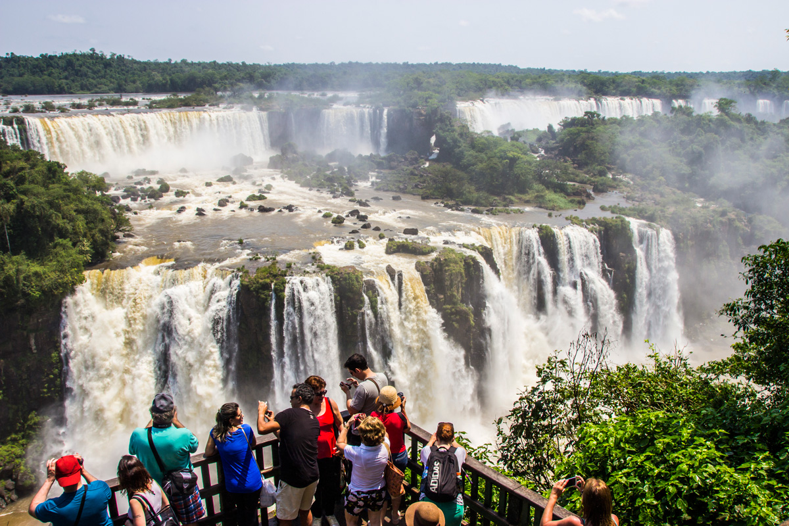
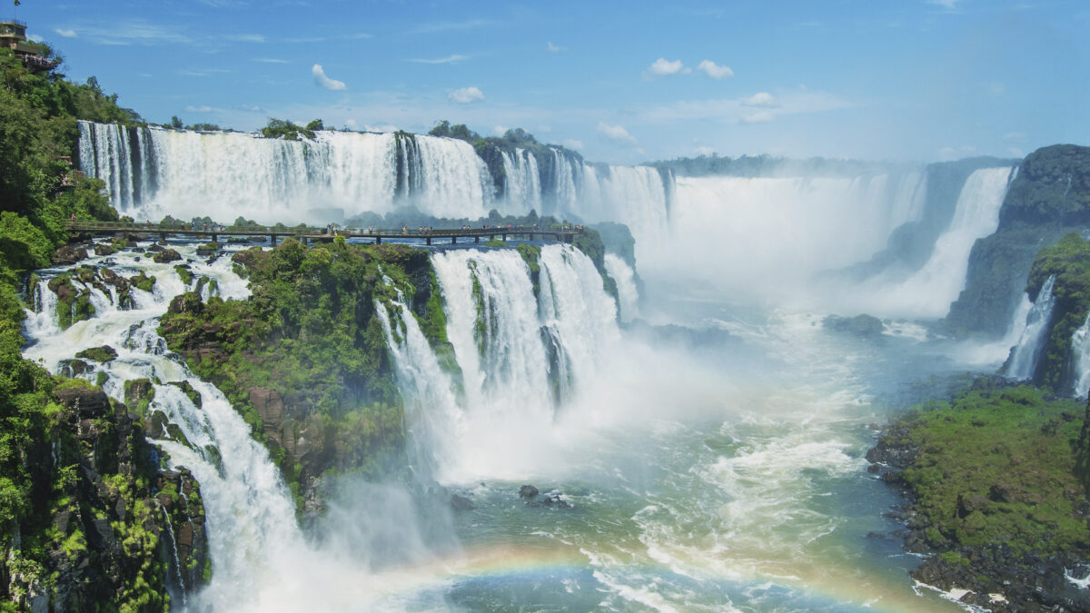
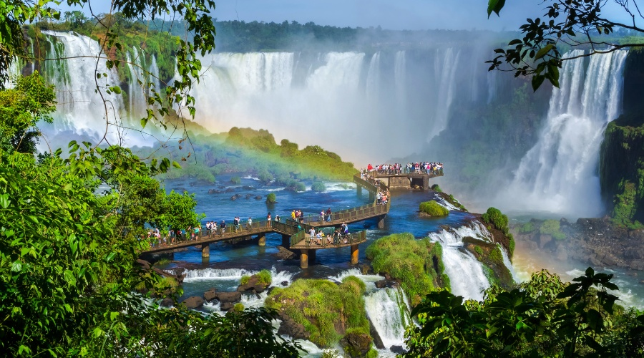
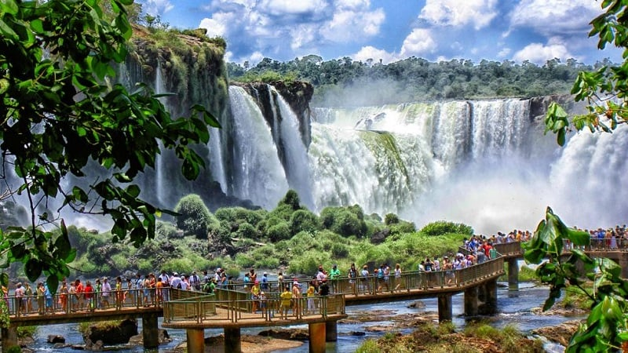
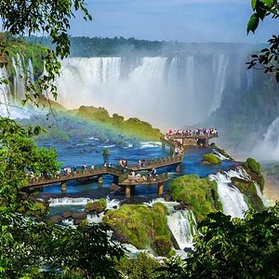
IGUAÇU FALLS
THE LARGEST COLLECTION OF WATERFALLS IN THE WORLD

Slide 22
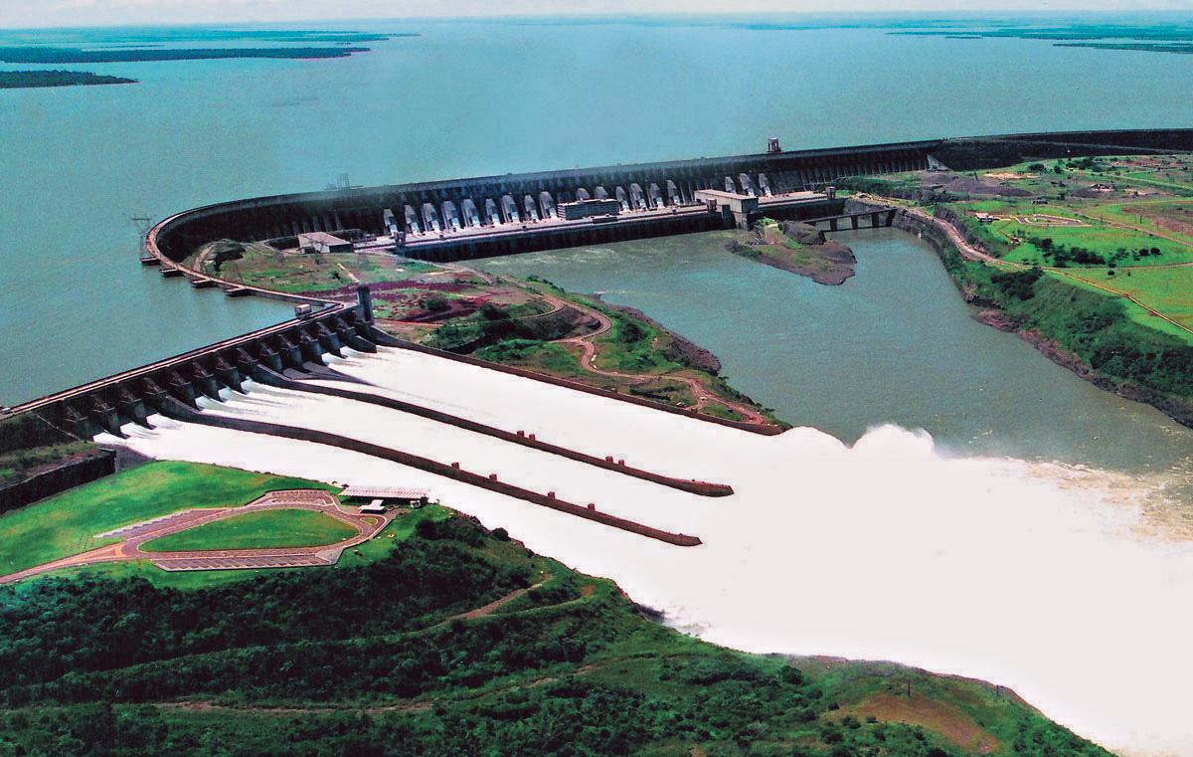
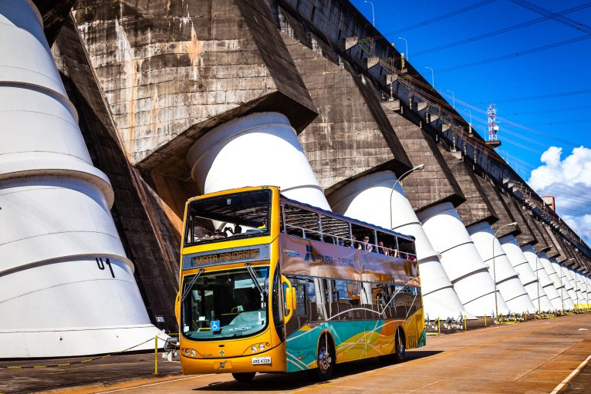
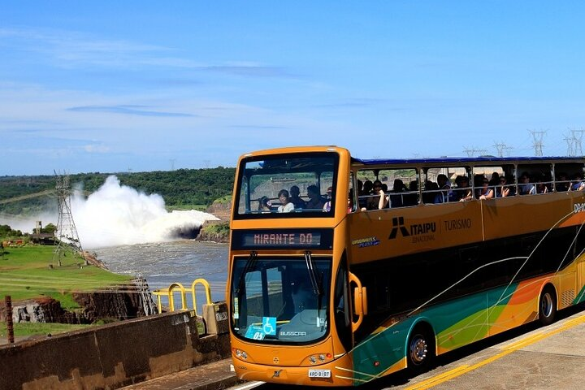
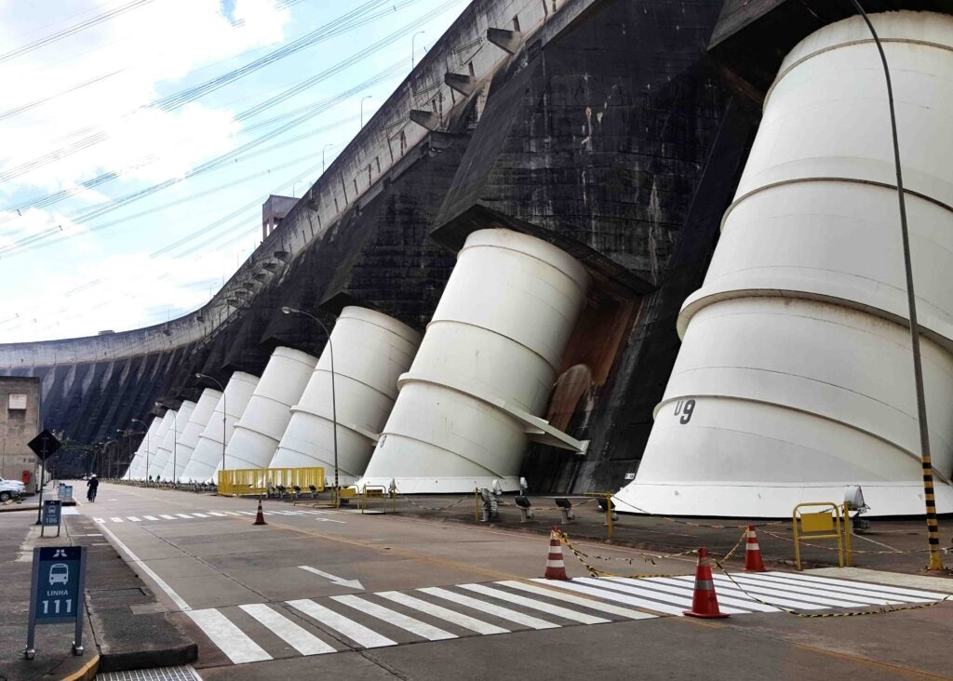
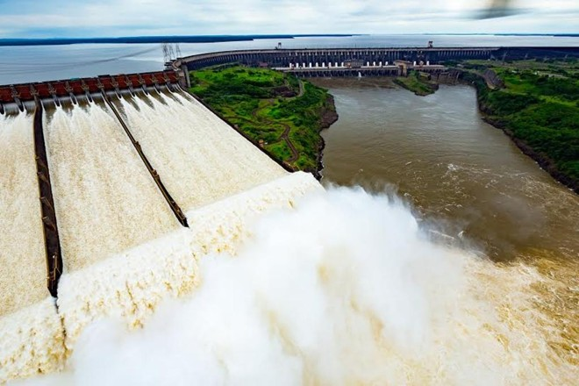
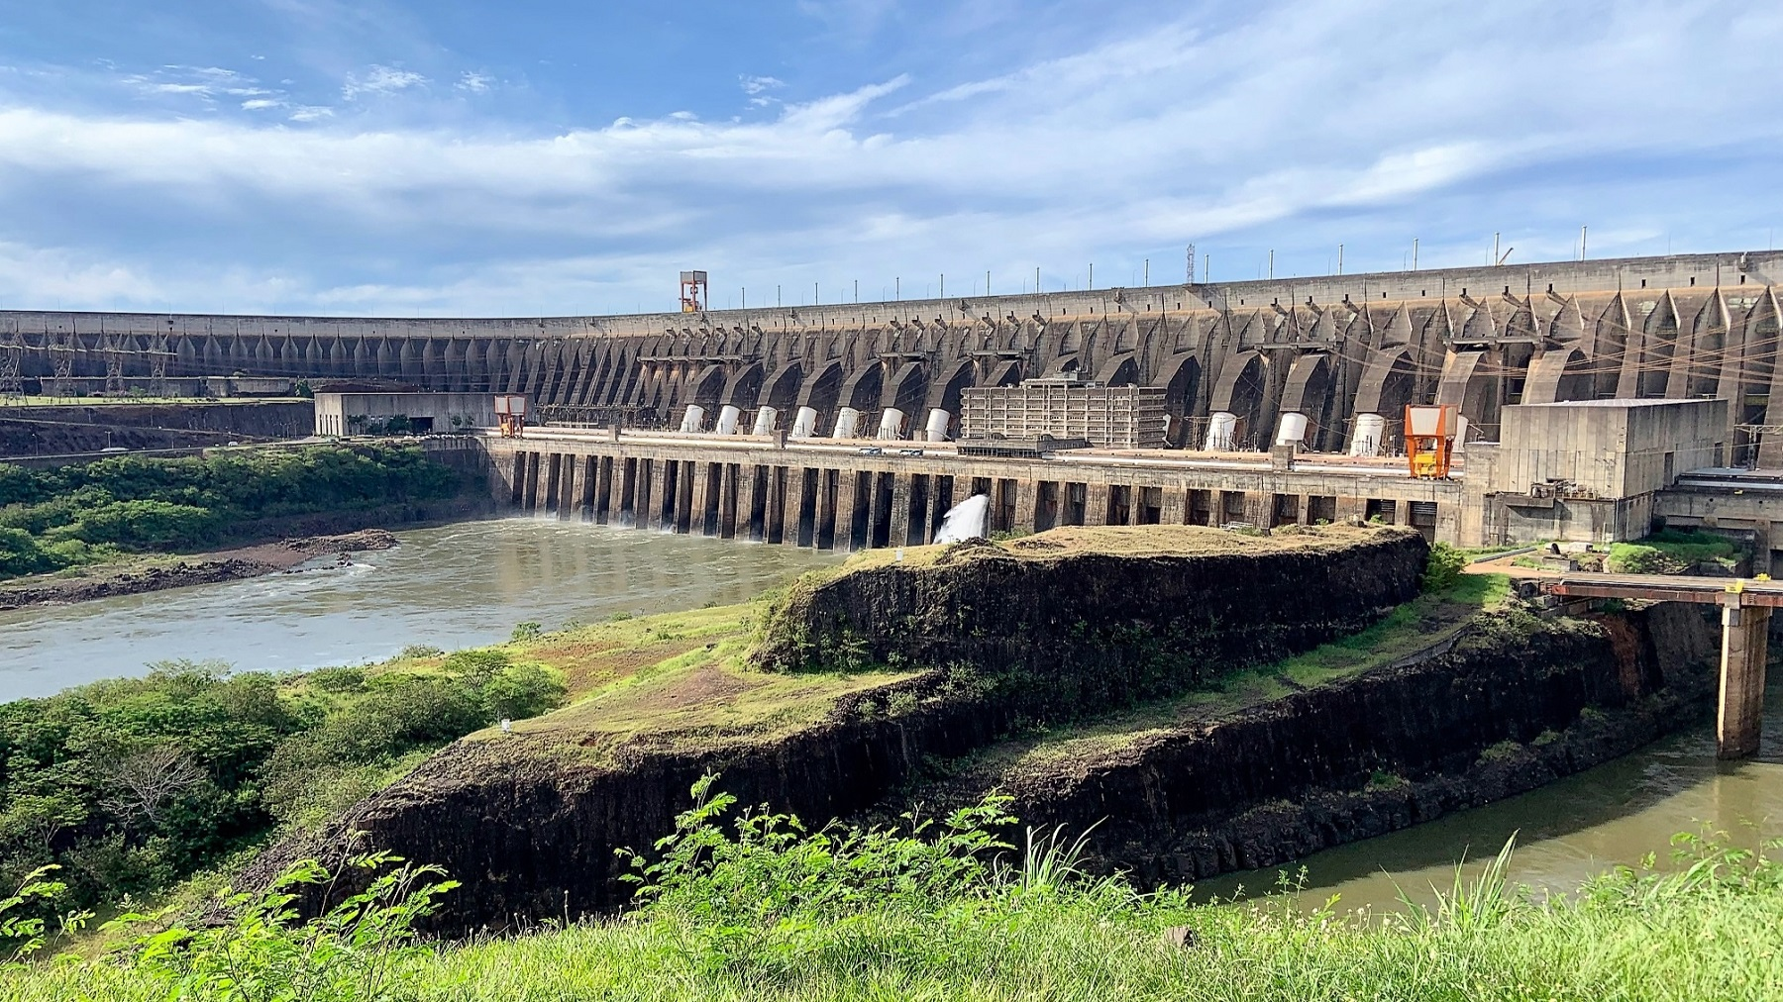
ITAIPÚ HYDROELECTRIC POWER PLANT
THE LARGEST PRODUCTION (ON AN ANNUAL BASIS) OF ELECTRICITY IN THE WORLD

Slide 23
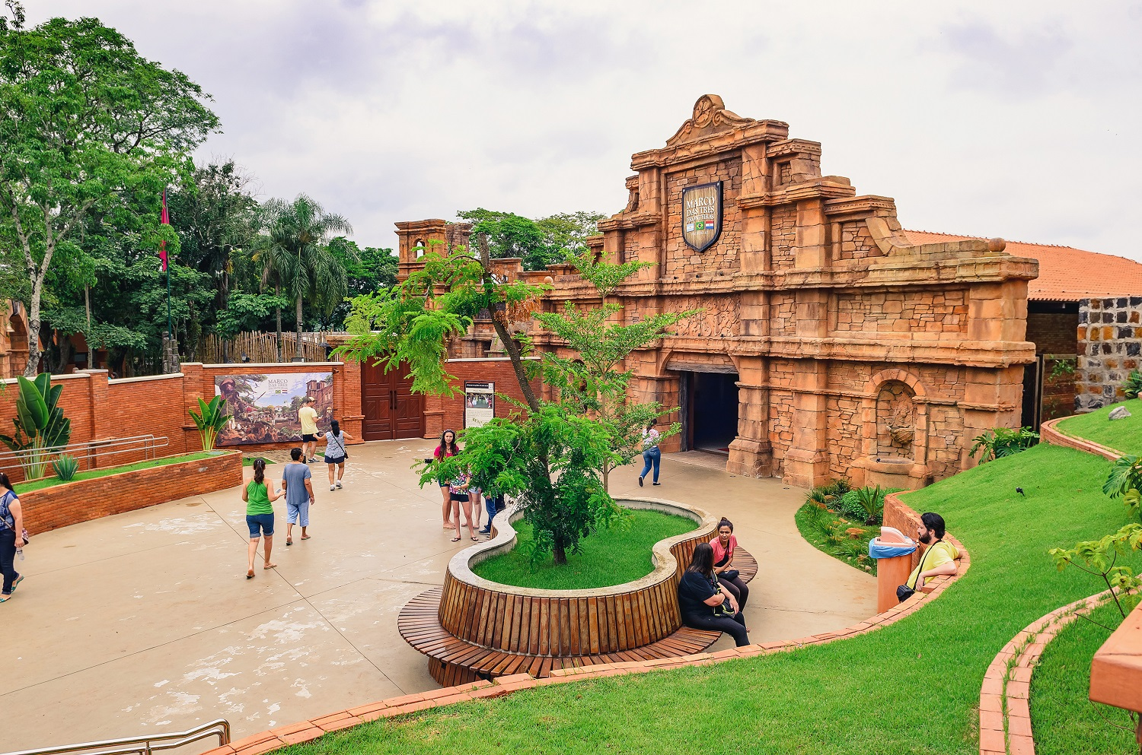
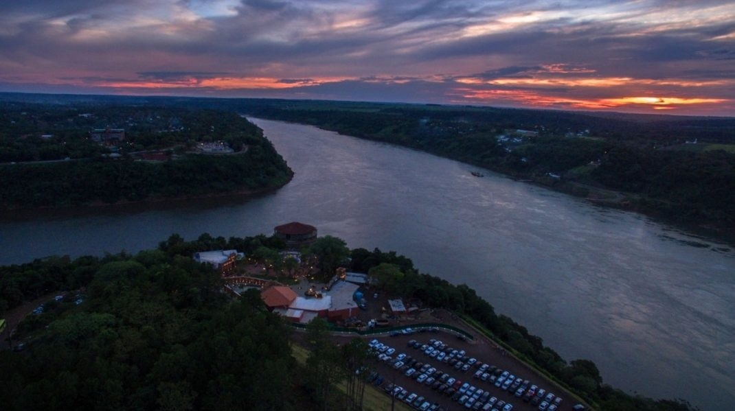
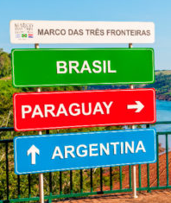
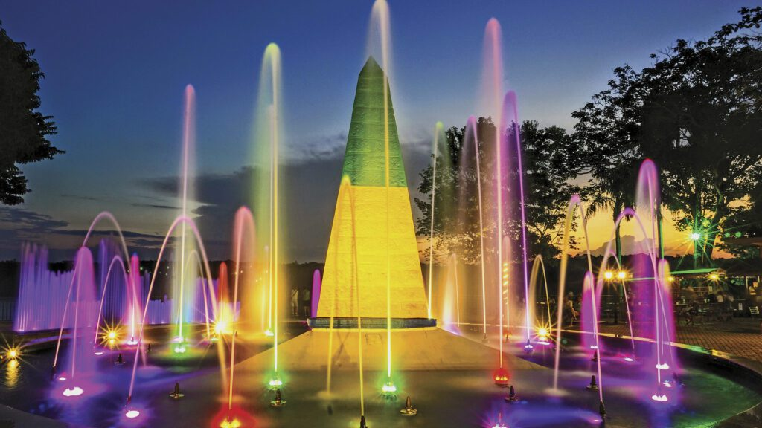
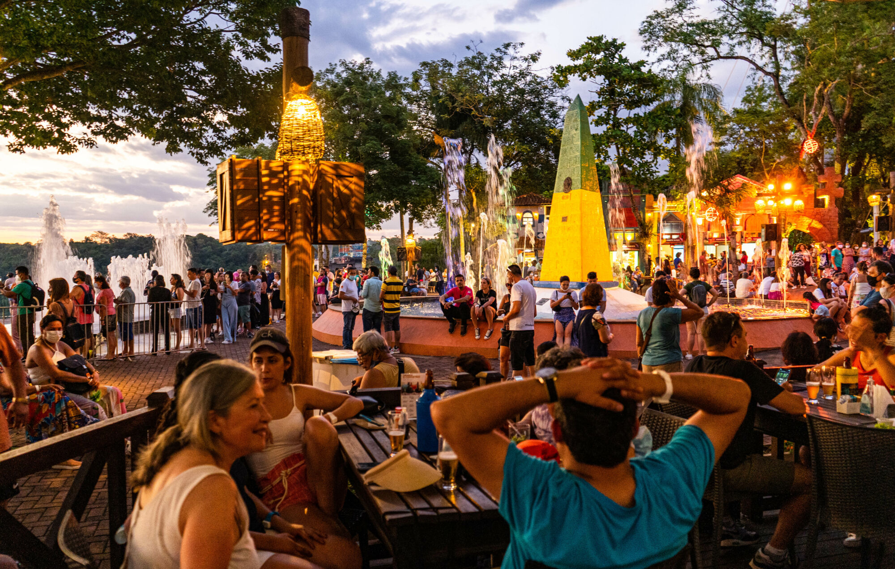
MARCO DAS TRÊS FRONTEIRAS (THREE BORDERS LANDMARK)
ARGENTINA
PARAGUAY
BRAZIL

Slide 24

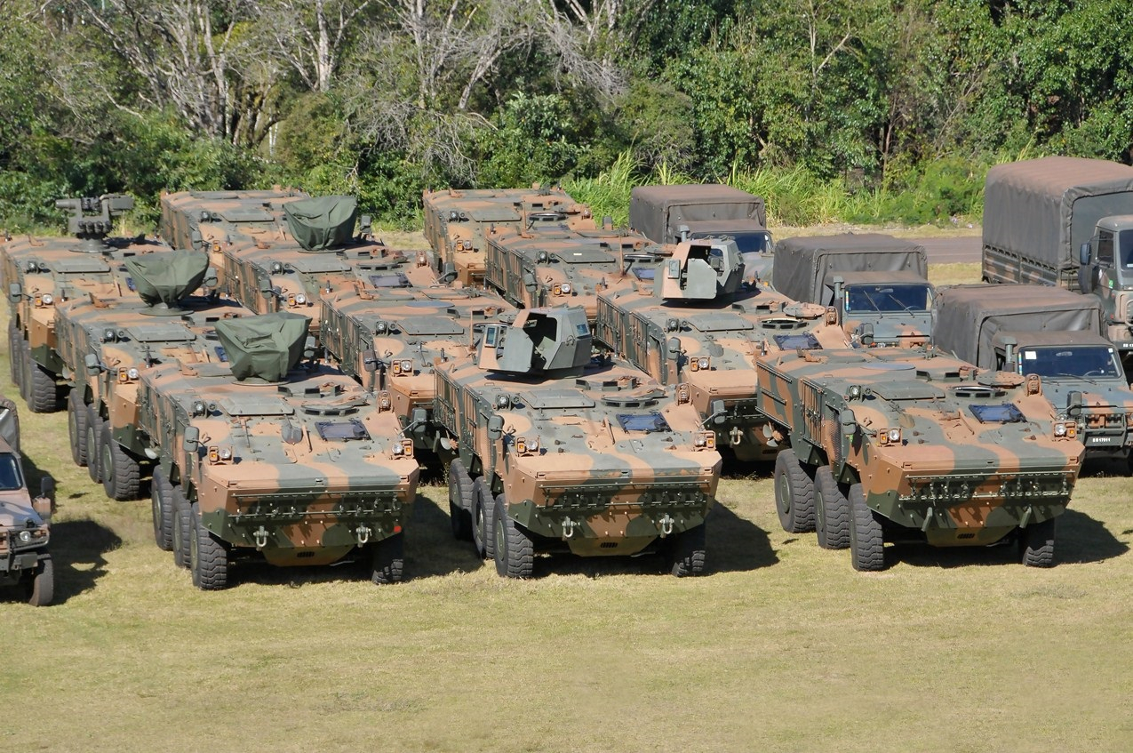
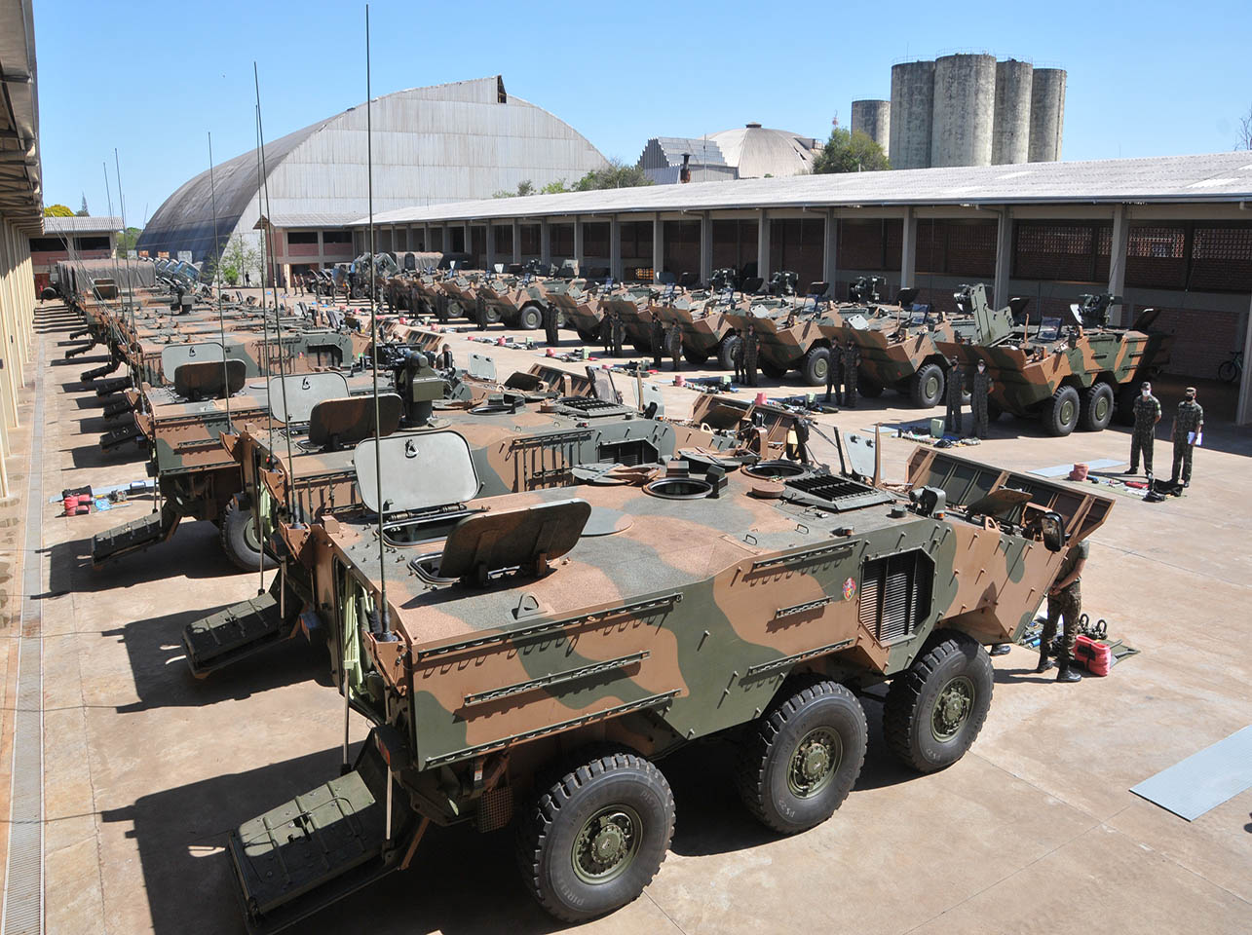
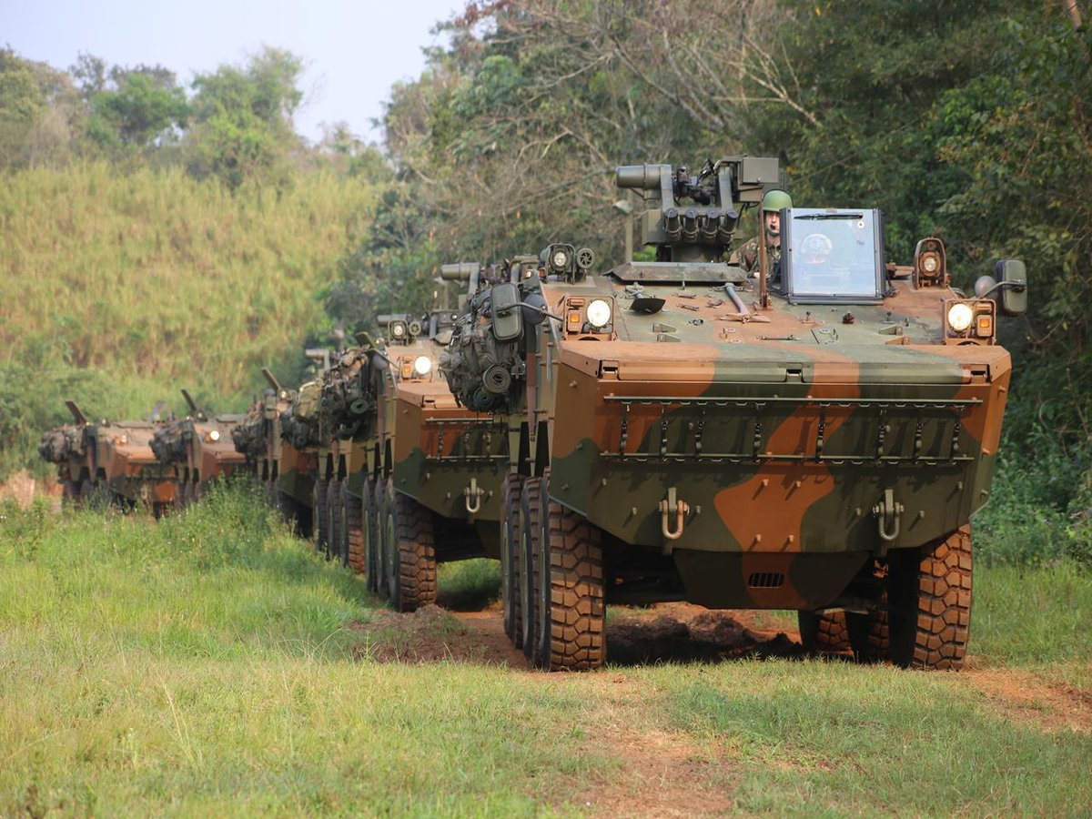
SOLDIER’S DAY CELEBRATIONS
MILITARY MATERIAL EXHIBITION

Slide 25
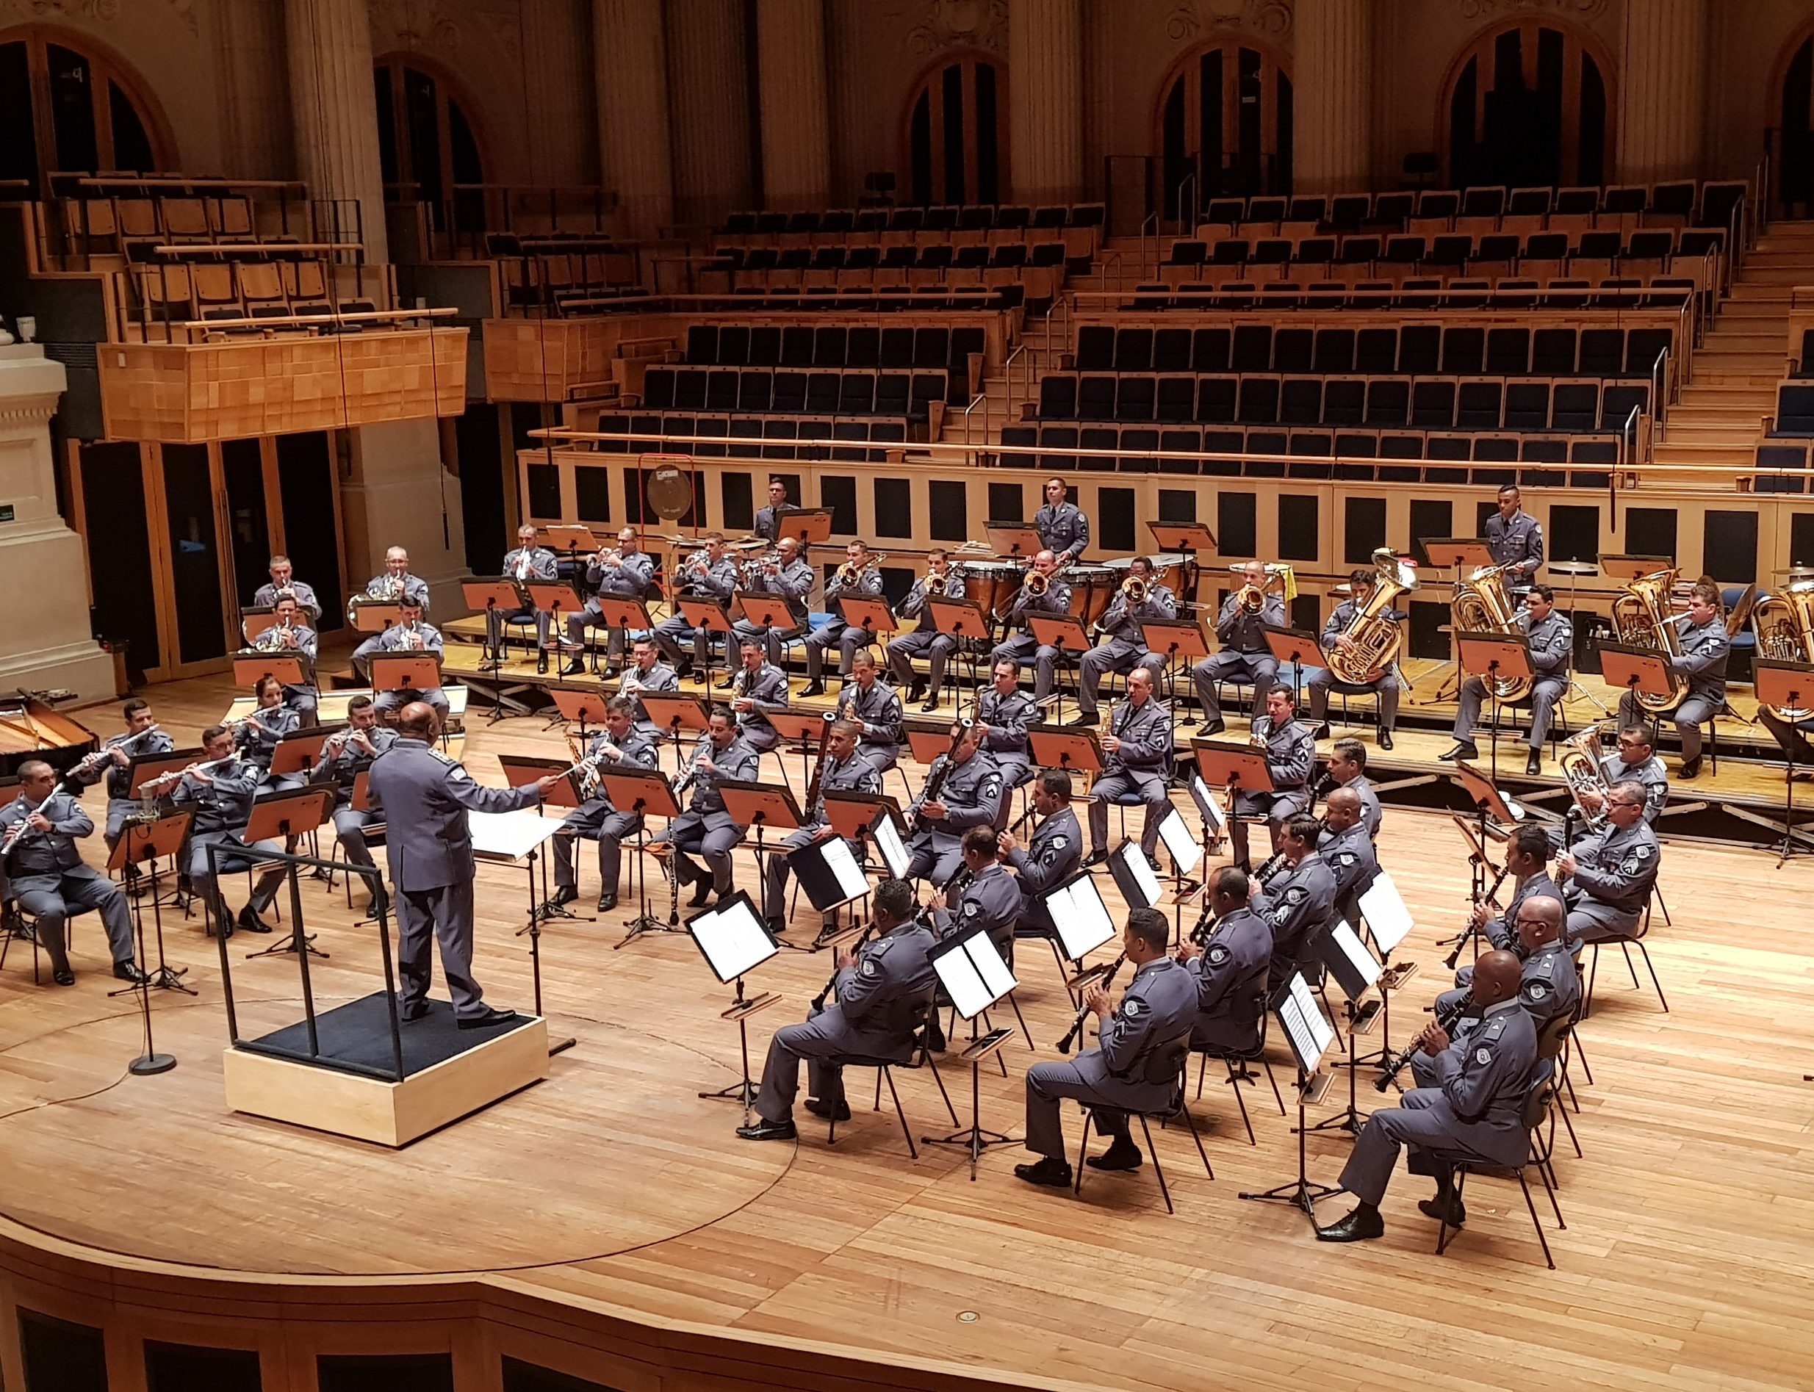
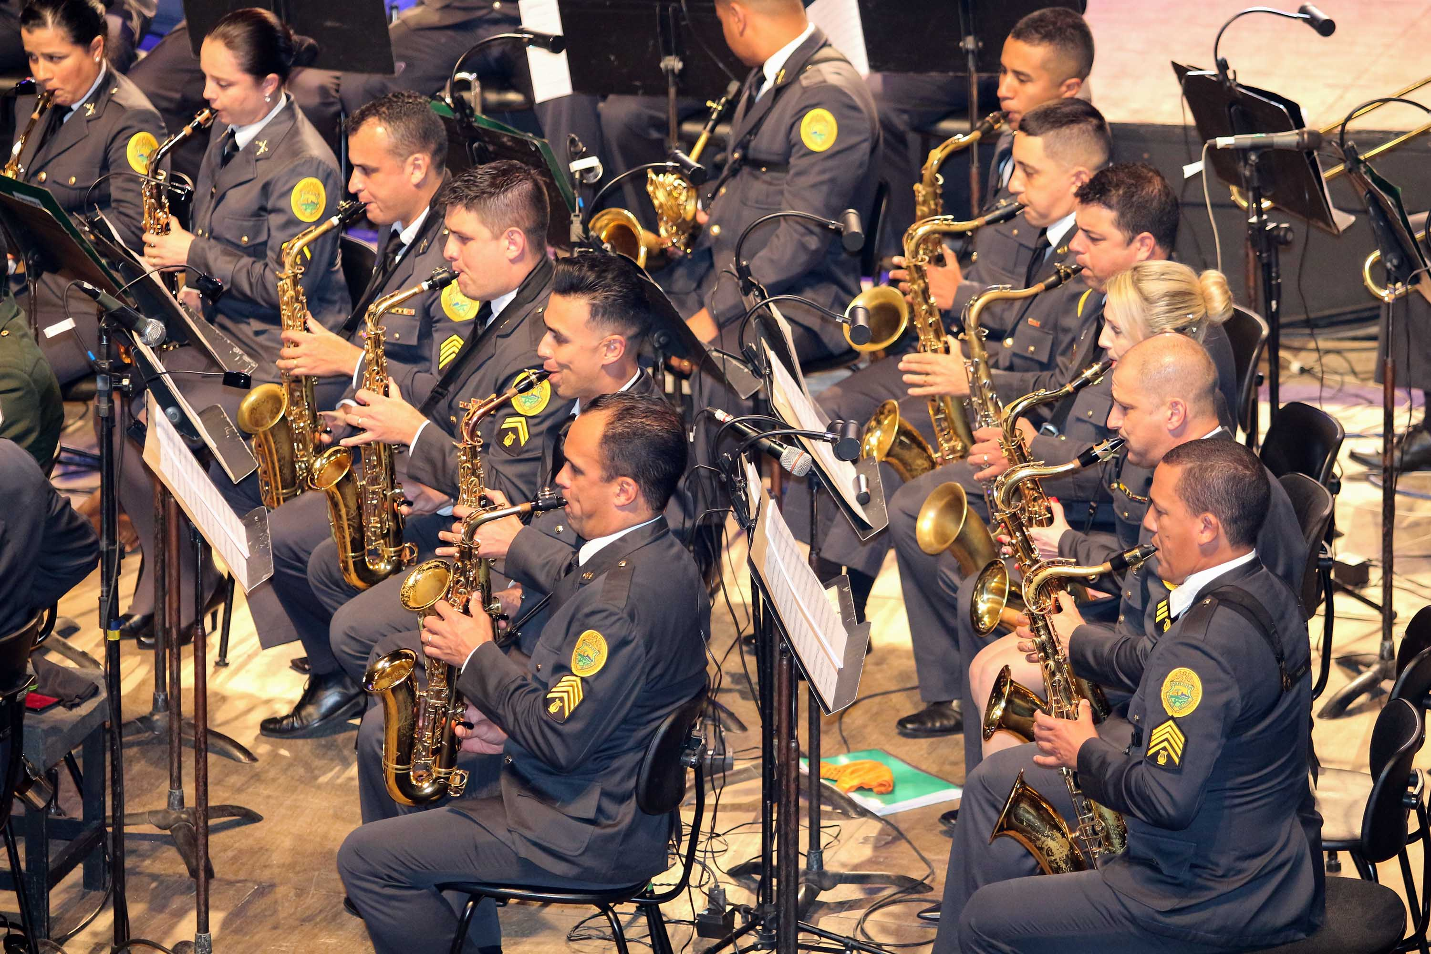
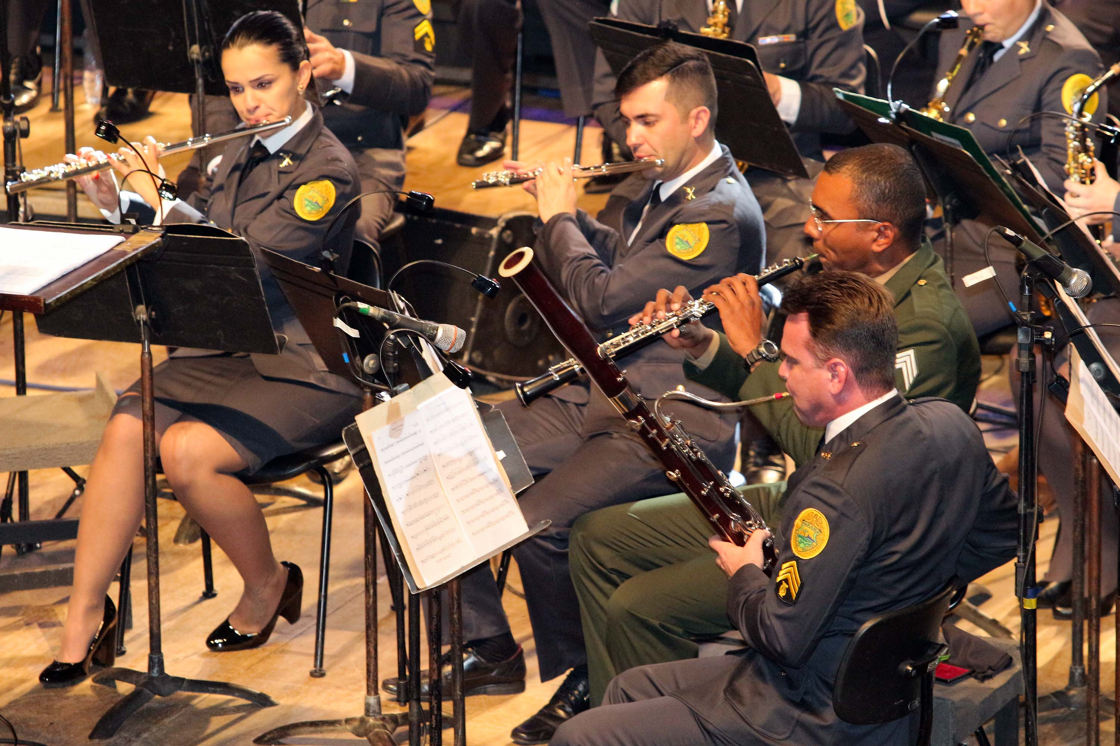

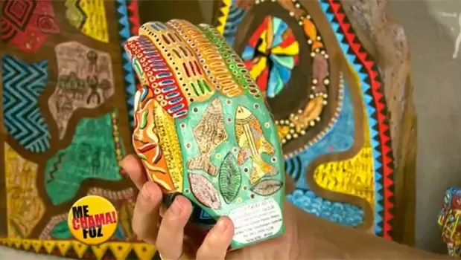
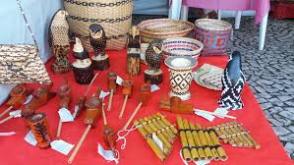
PERFORMANCE BY THE SYMPHONIC BAND OF THE PARANÁ STATE POLICE CORPS
CRAFTS AND EXHIBITIONS BY LOCAL ARTISTS

Slide 26
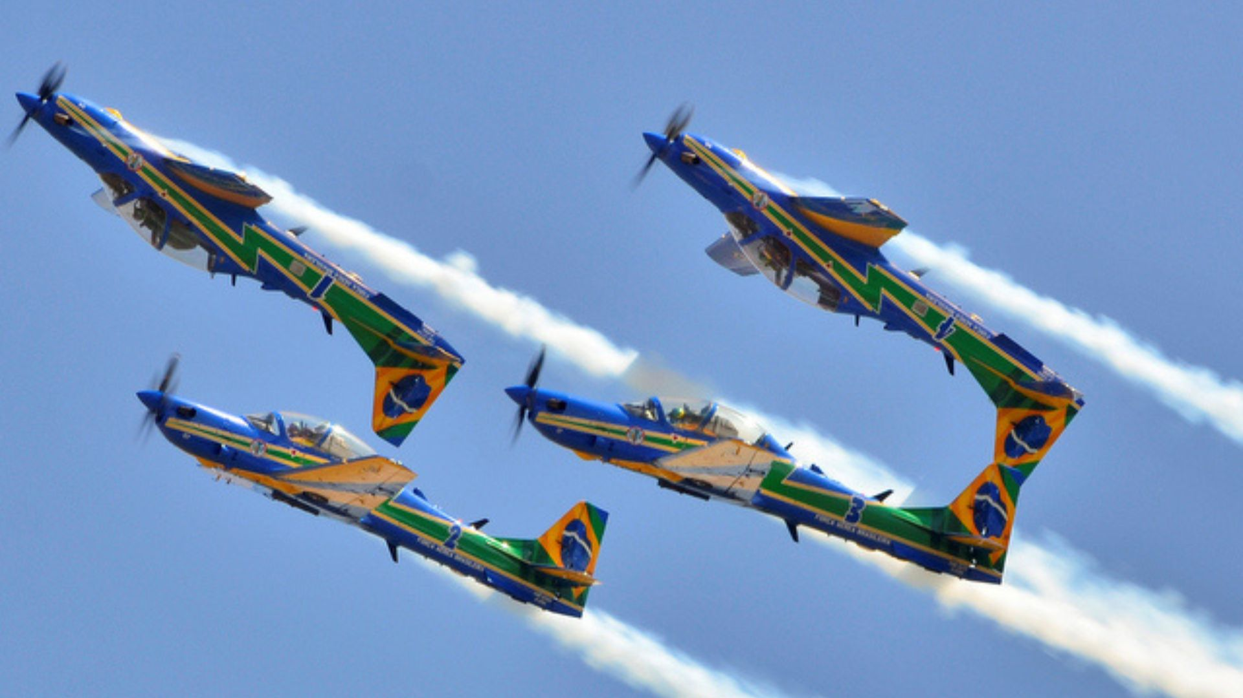
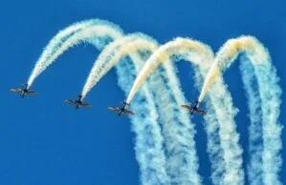
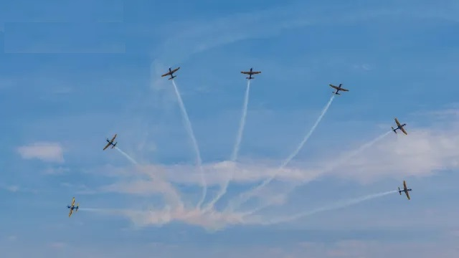
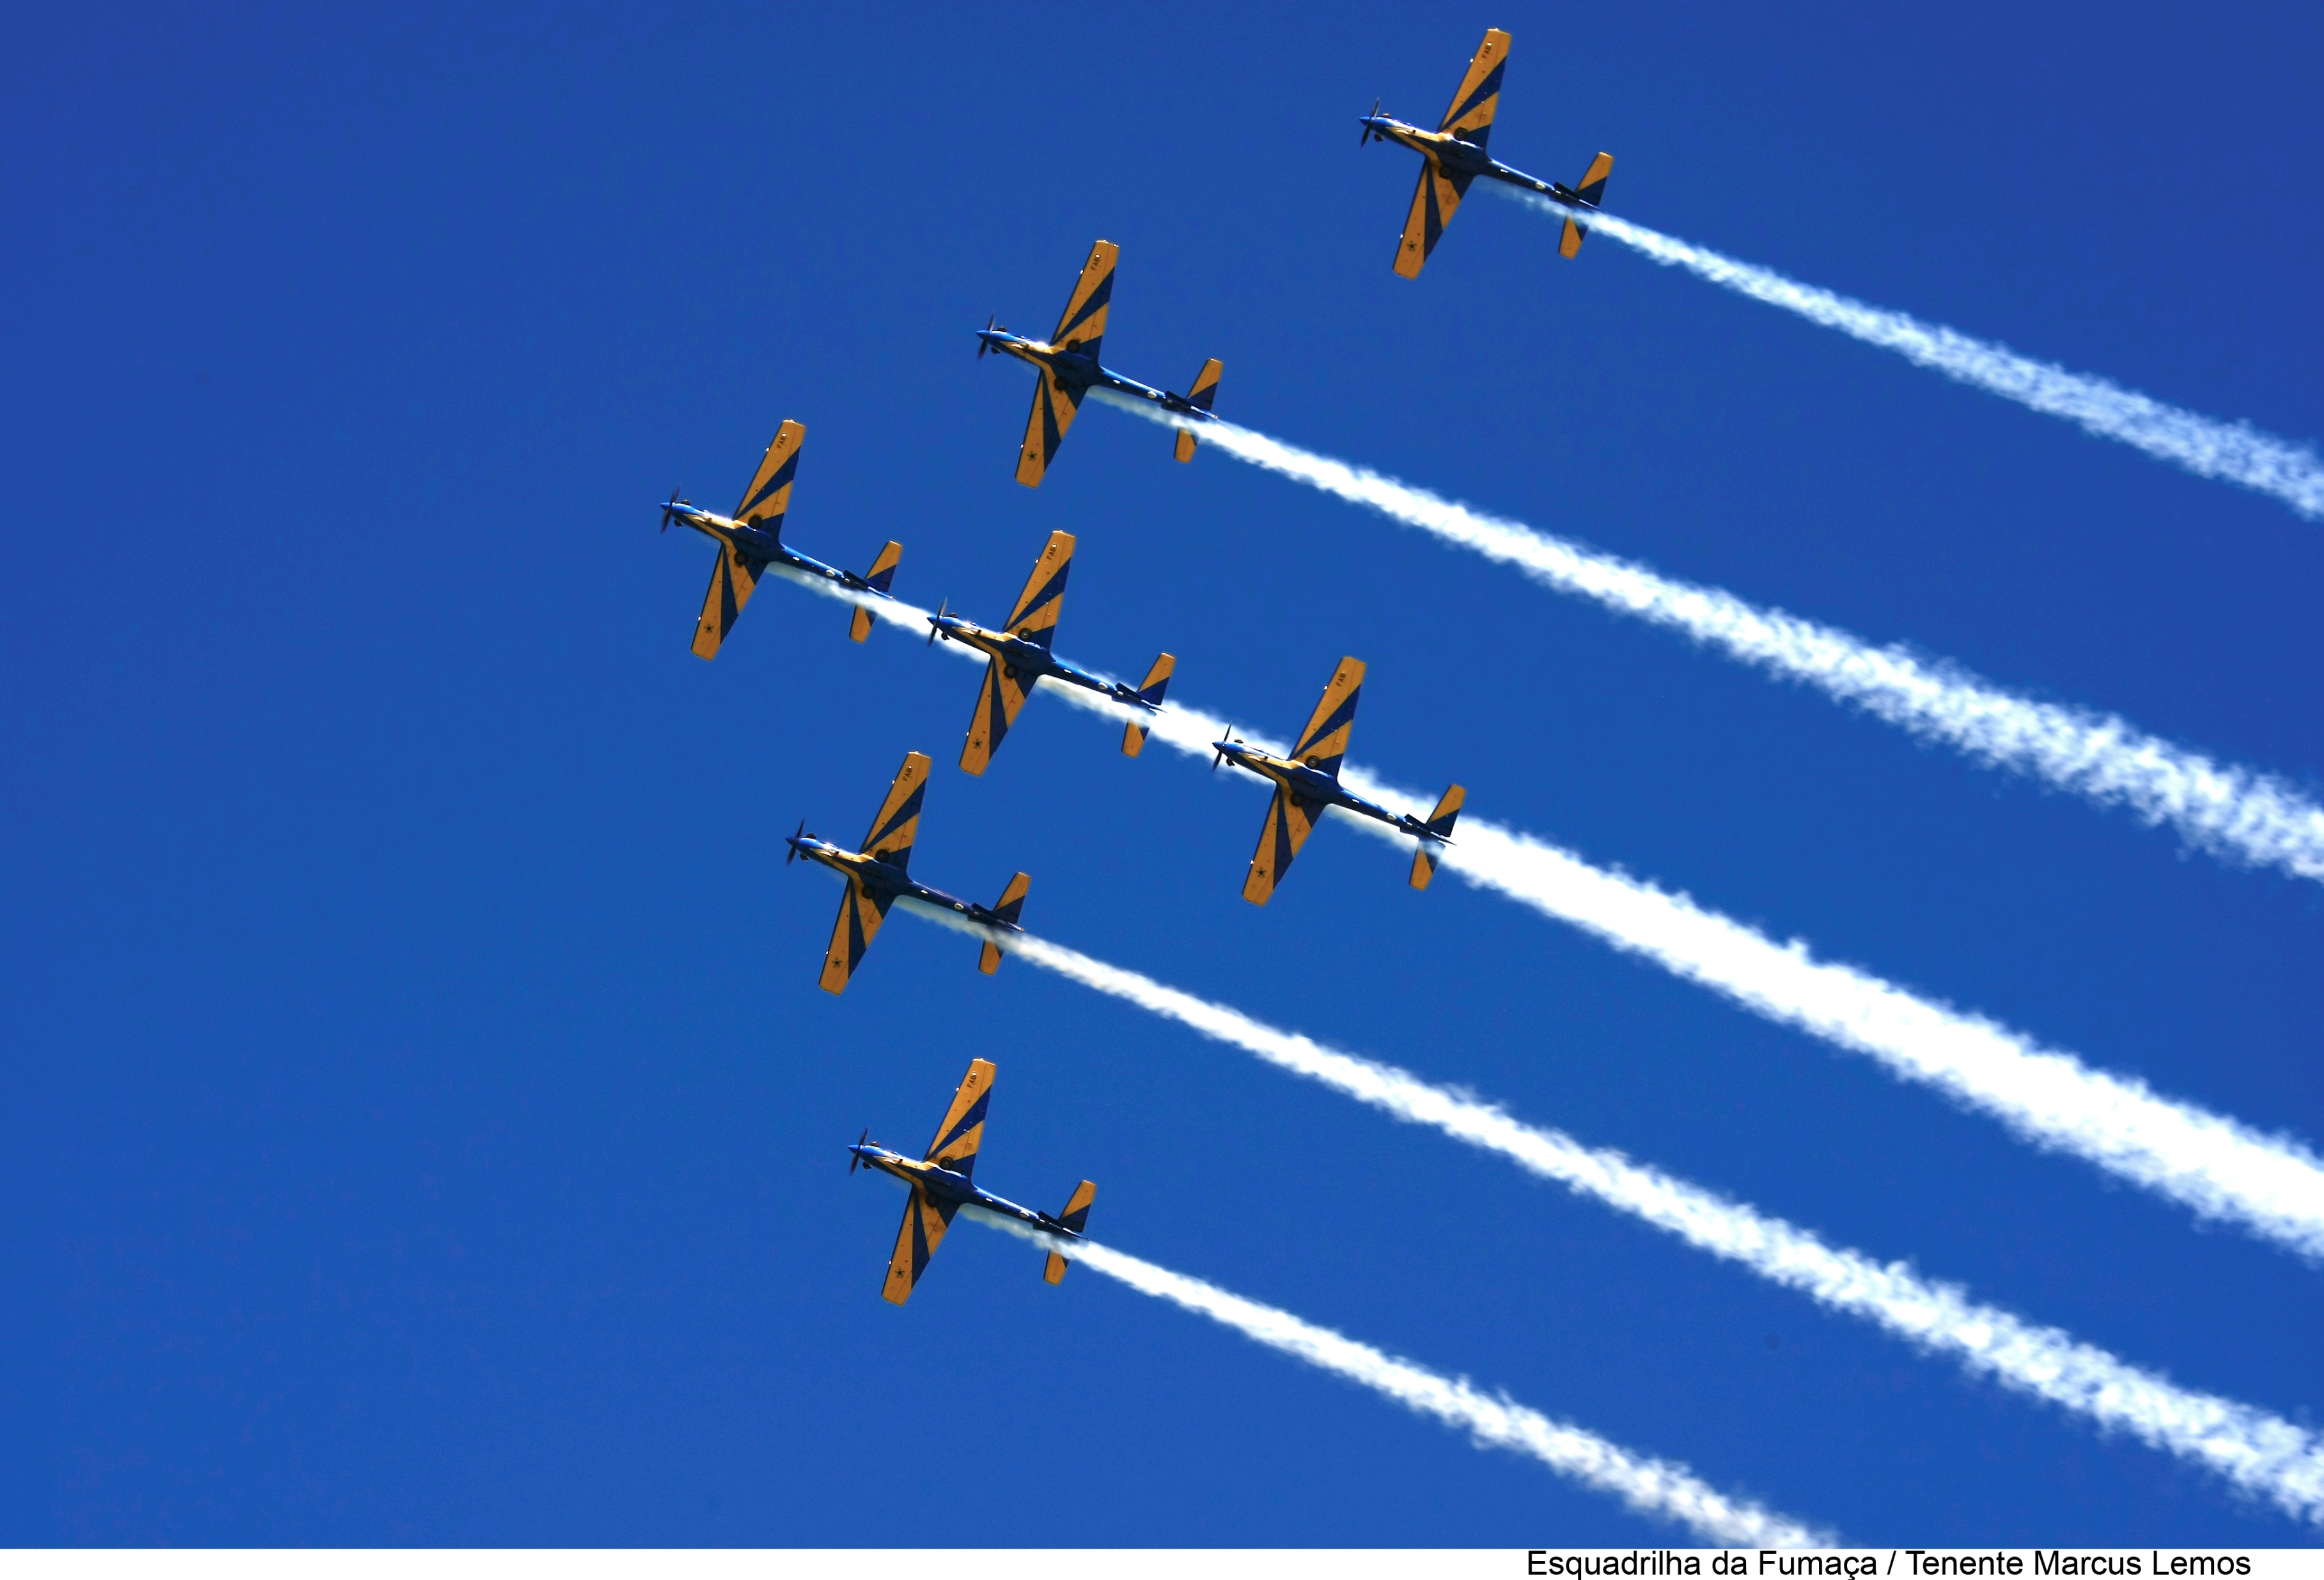
AIR SHOW - PRESENTATION OF THE AIR FORCE DEMONSTRATION SQUADRON

Slide 27
POST-CONGRESS TOUR
➔ VISIT A LARGE AGRIBUSINESS COMPANY
➔ ENJOY THE HOTEL PARK
➔ APPRECIATE THE CITY’S ATTRACTIONS
CITY ATTRACTIONS:
VISITS TO TEMPLES - RELIGIONS LIVING TOGETHER WITHOUT CONFLICT
KATTAMARAM RIDE
MACUCO SAFARI
RODA GIGANTE (FERRIS WHEEL) - YUP STAR
PARQUE DAS AVES (BIRDS PARK)
WONDER PARK FOZ

Slide 28






VISIT TO A LARGE AGRICULTURAL COMPANY (EVENT ALREADY REQUESTED AND CONFIRMED)

Slide 29




EXTRA ATTRACTION - CATANDUVAS BATTLEFIELD
CATANDUVAS WAS THE SCENE OF BATTLES DURING THE 1924 REVOLUTION. THE SMALL TOWN, WITH ONLY FIVE HOUSES AND A COMMERCIAL STORE, WAS A STRATEGIC POINT, AS IT HAD A TELEGRAPH, A VITAL STRUCTURE FOR THE REGION.

Slide 30

ACCOMPANYING PERSONS - SOCIAL ACTIVITIES
ENJOY THE HOTEL WATER PARK
ANNEX TO THE HOTEL.
USE INCLUDED FOR ACCOMPANYING.

Slide 31







Slide 32


RELIGIONS LIVING TOGETHER WITHOUT CONFLICT
CATEDRAL DE NOSSA SENHORA DE GUADALUPE
CATHEDRAL OF OUR LADY OF GUADALUPE

Slide 33




TEMPLO BUDISTA CHEN TIEN
CHEN TIEN BUDDHIST TEMPLE

Slide 34



MESQUITA OMAR IBN AL-KHATAB
OMAR IBN AL-KHATAB MOSQUE

Slide 35


KATTAMARAM
CATAMARAN TRIP (LUNCH OR DINNER ON BOARD)

Slide 36


MACUCO SAFARI
RODA GIGANTE
(FERRIS WHEEL) - YUP STAR
THE SIZE IS THE SAME AS RIO DE JANEIRO AND ALLOWS VIEWS OF THE CITY AND SOME OF ITS POSTCARDS FROM THE TOP OF ITS 88 METERS...

Slide 37










PARQUE DAS AVES (BIRDS PARK)

Slide 38




WONDER PARK FOZ
MOVIE CARS
BONNIE´S BURGER
WATER SHOW

Slide 39

ATTENTION - IMPORTANT NOTICE
VISITS TO CITIES IN NEIGHBORING COUNTRIES ARE NOT PROVIDED IN THE PROGRAMMING. COMMERCIAL AND GASTRONOMIC VISITS OR TOURS MAY BE CARRIED OUT, BUT EXCLUSIVELY IN A PRIVATE, PARTICULAR MANNER, AT THE ACCOUNT AND RISK OF THE INTERESTED PARTY.

